Slide 1
Study of two-particle response and phase changes in strongly correlated systems using Dynamical Mean Field Theory
Bismayan Chakrabarti
Dissertation defense
Supervisor: Prof. Kristjan Haule

Slide 2
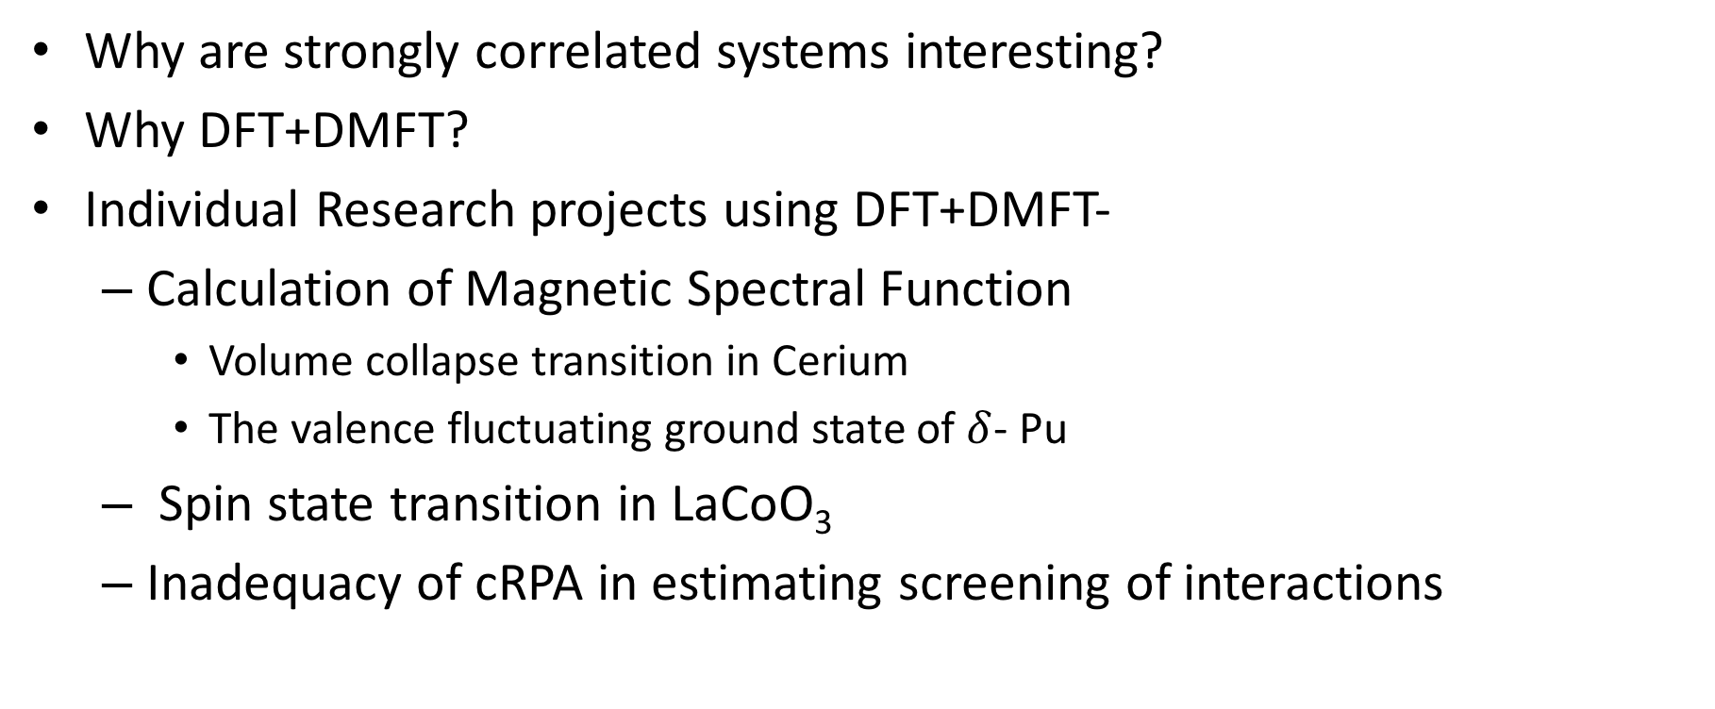
Contents
Why are strongly correlated systems interesting?
Why DFT+DMFT?
Individual Research projects using DFT+DMFT-
Calculation of Magnetic Spectral Function
Volume collapse transition in Cerium
The valence fluctuating ground state of $δ$- Pu
Spin state transition in LaCoO₃
Inadequacy of cRPA in estimating screening of interactions

Slide 3
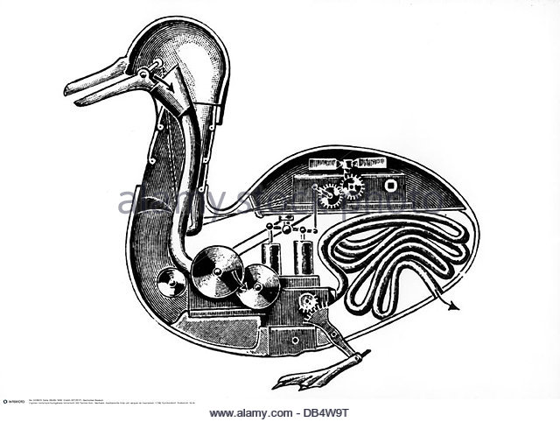
Condensed Matter- The study of Emergence
Traditional guiding light of Western Science: Reductionism
“Human science fragments everything in order to understand it, kills everything in order to examine it. ” ― Leo Tolstoy, War and Peace

Slide 4
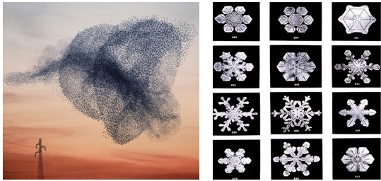
Condensed Matter- The study of Emergence
Condensed Matter: More is different – P.W. Anderson (1972)
Emergence: Collections of entities exhibit properties not trivially understood from properties of individual constituents.
Condensed Matter: The study of emergent phenomenon in material systems

Slide 5
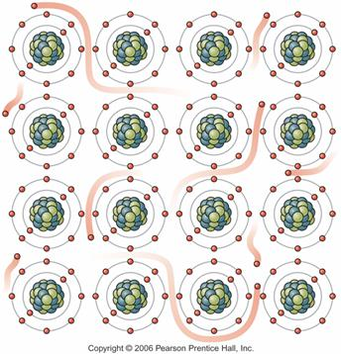
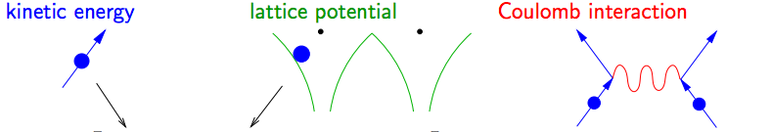
Can we understand macroscopic systems?
Fundamental equation governing the physics of all materials known in principle - Schrodinger Equation:
Can’t solve for macroscopic systems even with most powerful computers. Too many degrees of freedom (~10^23)
We must find efficient approximation schemes to make calculations computationally tractable

Slide 6
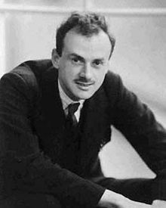
The underlying physical laws necessary for the mathematical theory of a large part of physics and the whole of chemistry are thus completely known, and the difficulty is only that the exact application of these laws leads to equations much too complicated to be soluble. It therefore becomes desirable that approximate practical methods of applying quantum mechanics should be developed, which can lead to an explanation of the main features of complex atomic systems without too much computation-Paul Dirac (1929)

Slide 7
Electronic correlations
Materials with open s or p shells – Weak electronic Correlations.
Landau Fermi Liquid Theory works well.
Density Functional Theory (DFT) extremely successful even with simplistic treatment of electronic correlations.
Put in Kohn Sham Pics
Materials with open d or f shells:
More localized electrons! Stronger Electronic Correlations
DFT Fails !
Must formulate alternate methods

Slide 8
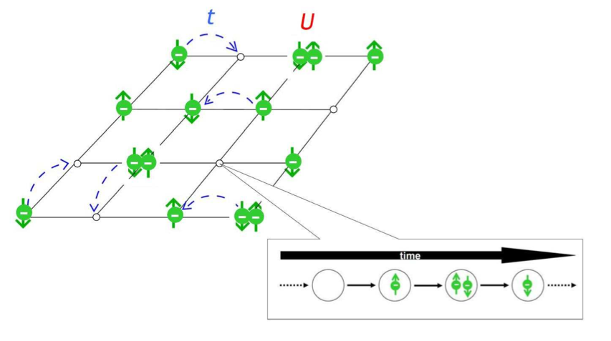
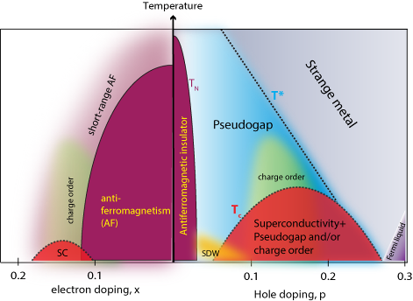
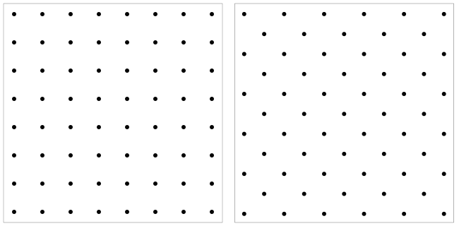
Strongly correlated systems
Most Famous model to study strong correlations: Hubbard Model
Interesting Physics in intermediate regime- Interplay of localization/itineracy
U / t ~ 0
U / t ~ O(1)
U / t >>1
Itinerant
Strongly Correlated Materials
Localized
Highly complex phase diagrams!!
Metal-insulator transition
High Tc superconductivity
Heavy fermions.

Slide 9
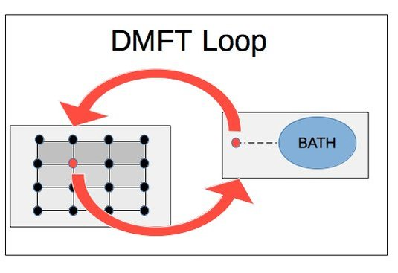

The DMFT approximation
Simulating strongly correlated systems hard: Solve true many body equation?
No! Use Dynamical Mean Field Theory (DMFT)
Lattice Problem with interactions
Impurity coupled to self-consistently determined bath
Exact in infinite dimensional limit
Computational impurity solvers exist!

Slide 10
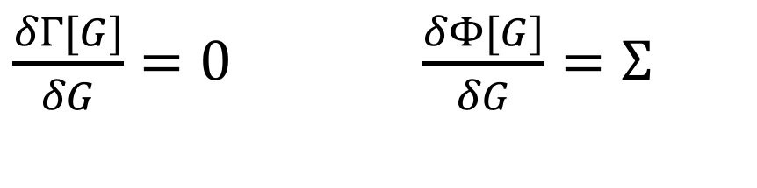
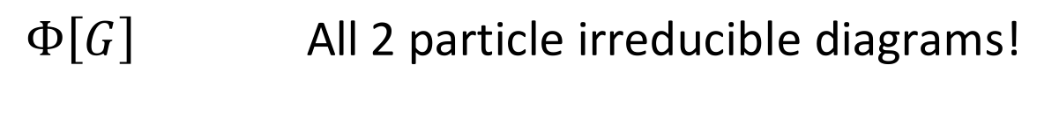
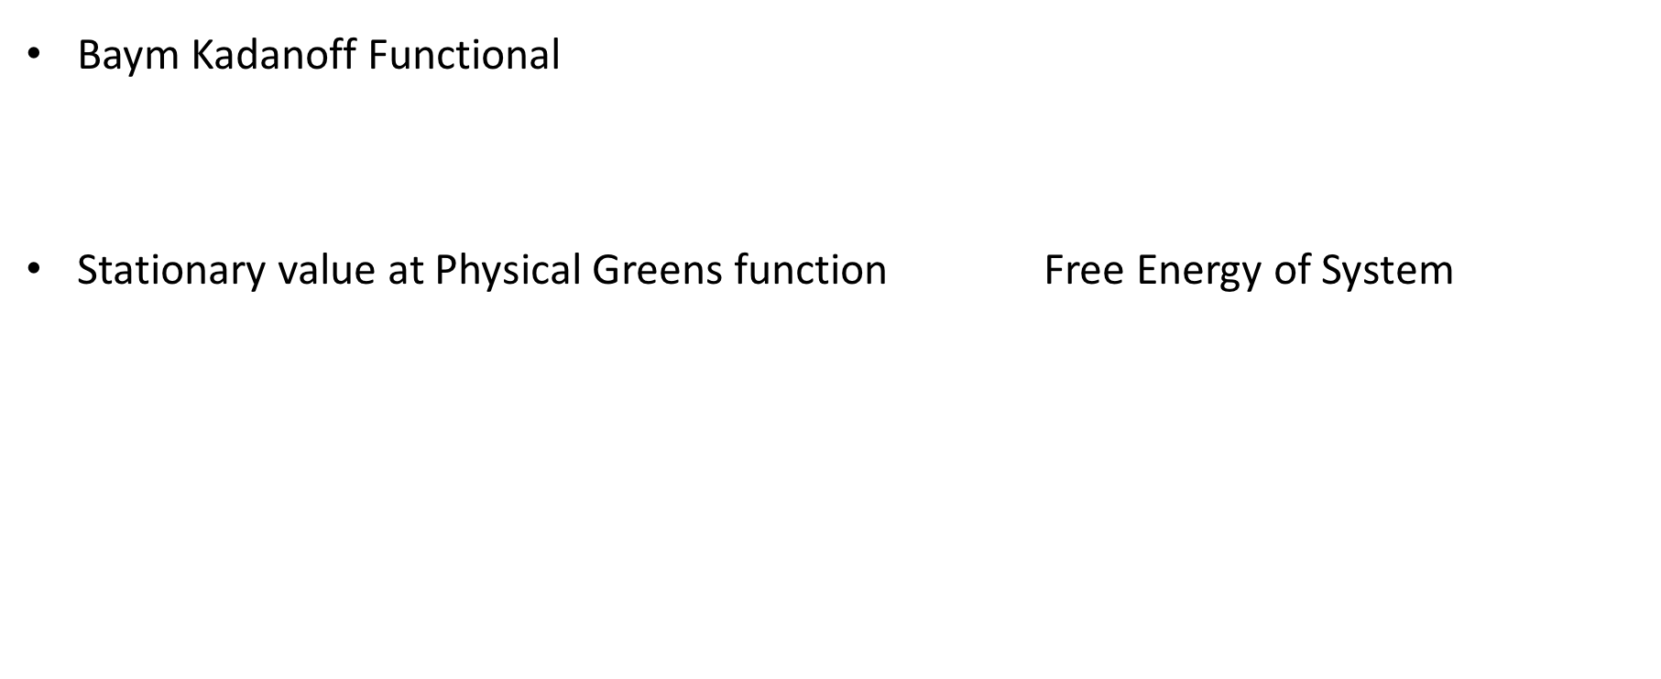
The DMFT approximation: An alternative approach
Baym Kadanoff Functional
Stationary value at Physical Greens function Free Energy of System
$$Γ\text{[}\text{G}\text{]=}\text{Tr}\left(\log\left(−\text{G}\right)\right)−\text{Tr}\left(Σ\left[G\right]G\right)+Φ[G]$$
$\frac{δΓ[G]}{δG}=0$ $\frac{δΦ[G]}{δG}=Σ$
$$Φ\left[G\right] \text{All}\text{ 2 }\text{particle} \text{irreducible} \text{diagrams}\text{!}$$

Slide 11

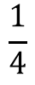
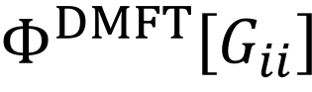
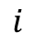
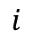
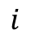
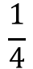
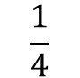
Full Luttinger Ward Functional:
DMFT Approximation- Replace all Greens functions by Local Greens functions
$$Φ\left[G\right]$$
$$\frac{1}{2}$$
$$\frac{1}{2}$$
$$\frac{1}{4}$$
$$\frac{1}{4}$$
$$i$$
$$i$$
$$i$$
$$Φ^{DMFT}\left[G_{ii}\right]$$
$$\frac{1}{2}$$
$$\frac{1}{2}$$
$$\frac{1}{4}$$
$$\frac{1}{4}$$
$$i$$
$$i$$
$$i$$
$$i$$
$$i$$
$$i$$
$$i$$
$$i$$
$$i$$
$$i$$
Self Energy Becomes Local

Slide 12
Merging DFT with DMFT
DMFT good at dealing with local correlations: treat d and f shells
Too computationally expensive to treat all orbitals
DFT excellent for weakly correlated orbitals
Computationally cheap but can’t simulate correlated orbitals
Combine them DFT+DMFT : State of the art method to perform ab initio simulations of correlated materials
DFT
DFT+DMFT
DMFT

Slide 13
DFT+DMFT
Allows us to perform ab-initio simulations of actual material systems with open d or f shell elements
Allows for finite temperature simulations unlike DFT
State of the art impurity solvers allow a wide variety of experimental observables to be calculated
Caveats-
Can be computationally expensive (f-shell elements like Pu require hundreds of thousands of computer hours)
For some impurity solvers, require analytic continuation
Double Counting: Eliminate the part of electronic correlations that are captured by both DMFT and DFT to avoid over-estimation of Coulomb term

Slide 14
Selected Research Projects using DMFT

Slide 15
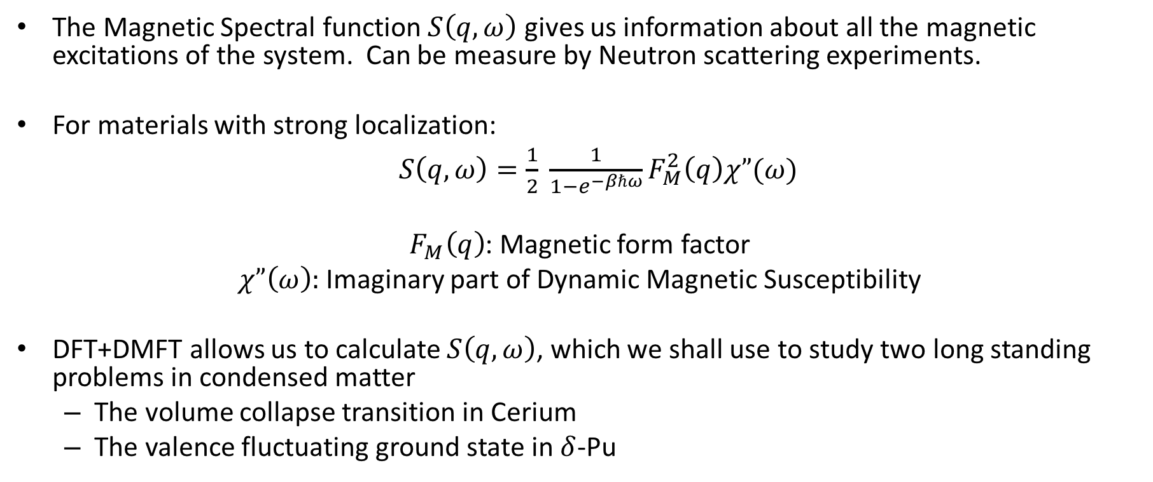
Calculation of Magnetic Spectral function
The Magnetic Spectral function $S\left(q,ω\right)$ gives us information about all the magnetic excitations of the system. Can be measure by Neutron scattering experiments.
For materials with strong localization:
$S\left(q,ω\right)=\frac{1}{2} \frac{1}{1−e^{−βℏω}}F_{M}^{2}\left(q\right)χ”(ω)$
$F_{M}\left(q\right)$: Magnetic form factor
$χ”\left(ω\right):$Imaginary part of Dynamic Magnetic Susceptibility
DFT+DMFT allows us to calculate $S\left(q,ω\right)$, which we shall use to study two long standing problems in condensed matter
The volume collapse transition in Cerium
The valence fluctuating ground state in $δ$-Pu

Slide 16
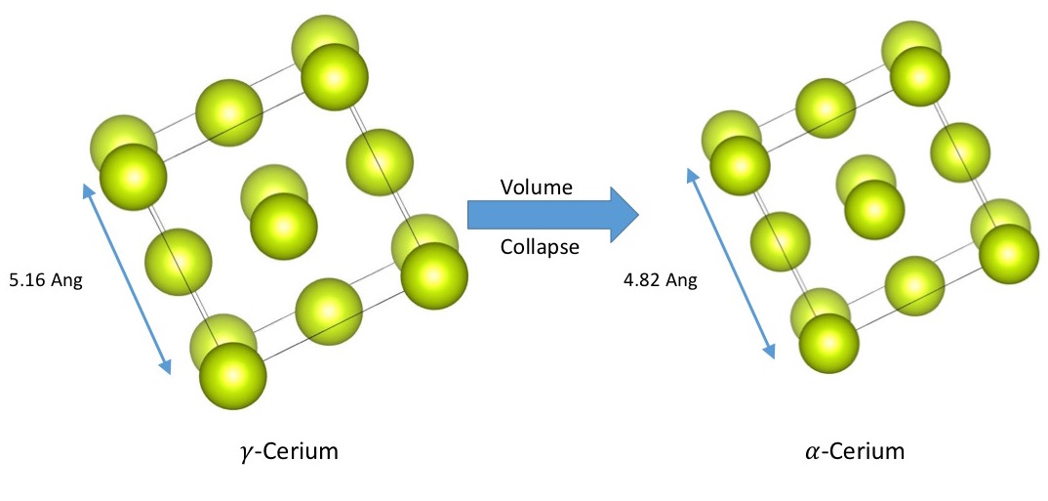
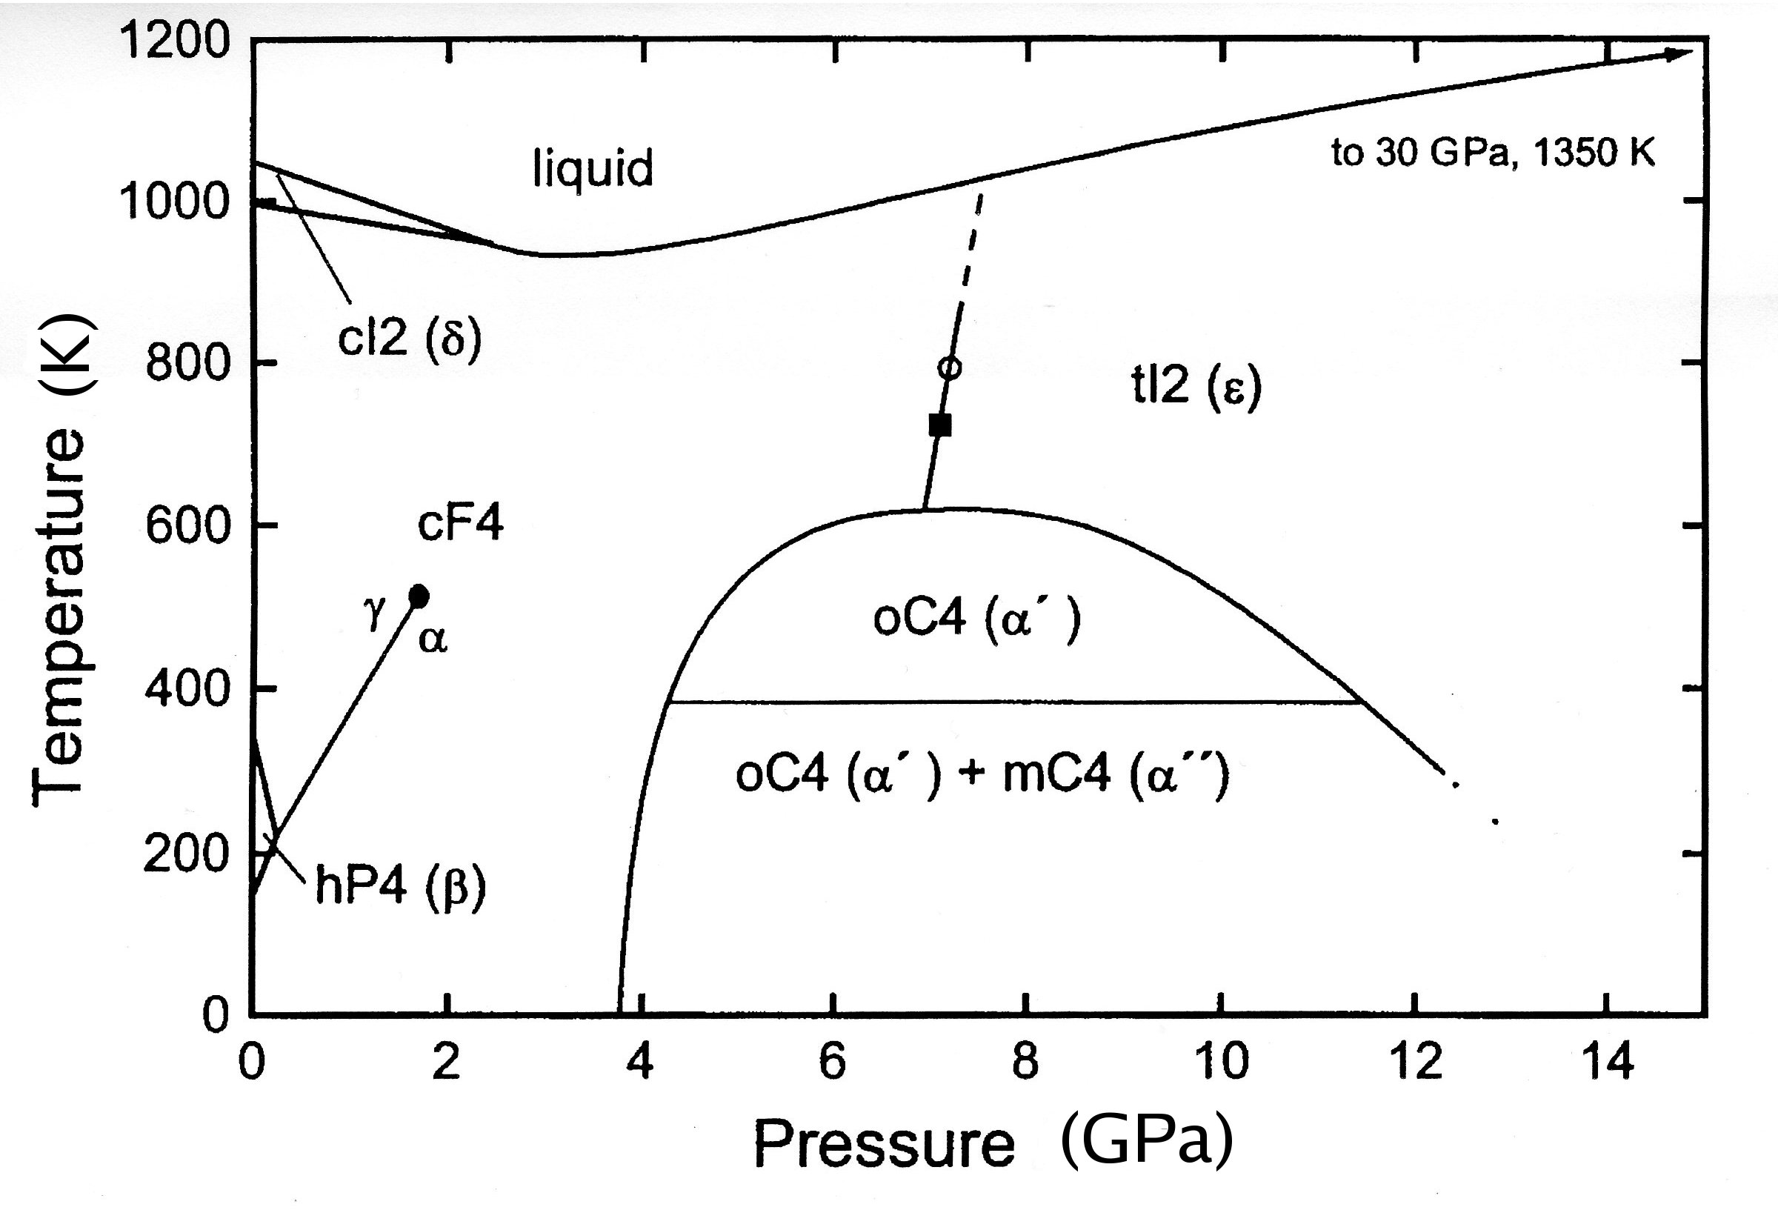
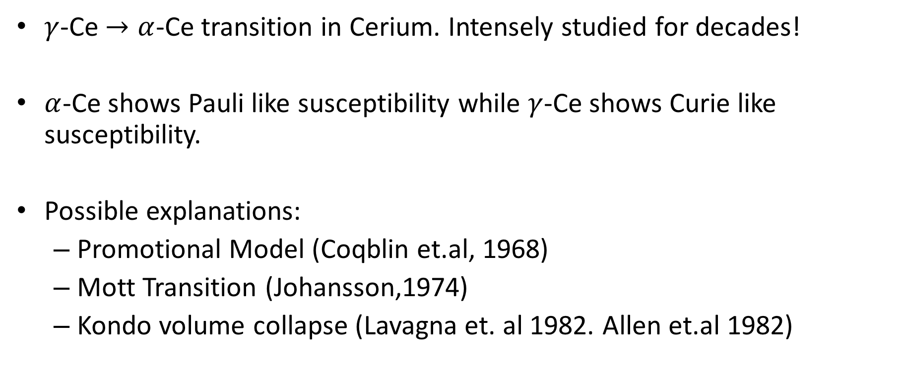
Volume Collapse transition in Cerium
$γ$-Ce $→α$-Ce transition in Cerium. Intensely studied for decades!
$α$-Ce shows Pauli like susceptibility while $γ$-Ce shows Curie like susceptibility.
Possible explanations:
Promotional Model (Coqblin et.al, 1968)
Mott Transition (Johansson,1974)
Kondo volume collapse (Lavagna et. al 1982. Allen et.al 1982)
Increase Pressure

Slide 17
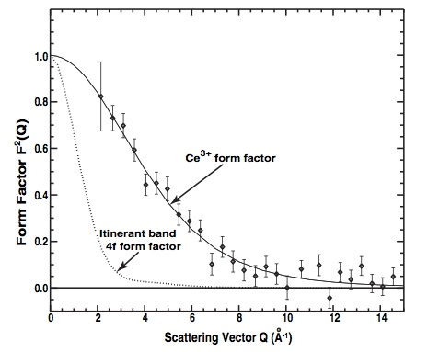
The form factor puzzle
Murani et.al (PRL 95, 256403):
LDA calculation assuming 4f electron forms itinerant band
Form factor remains unchanged across transition
4f electrons remain correlated across the transition!
Disagrees with DFT

Slide 18
DMFT results for F_{M}(q)
DMFT results in perfect agreement with experiment!

Slide 19
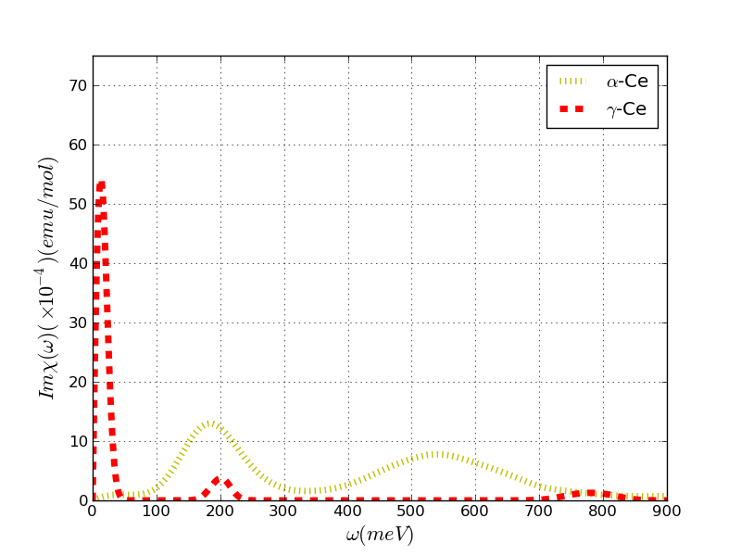
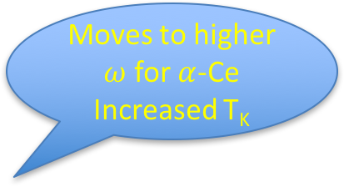
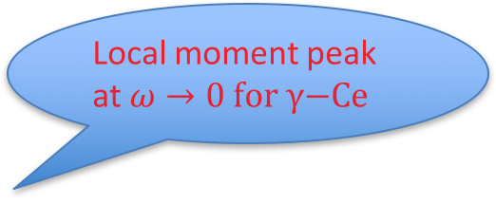

DMFT results for $χ”(ω)$
Local moment peak at $ω→0 \text{for} γ\text{−}\text{Ce}$
Increased Hybridization
Moves to higher $ω$ for $α$-Ce
Increased T_{K}

Slide 20
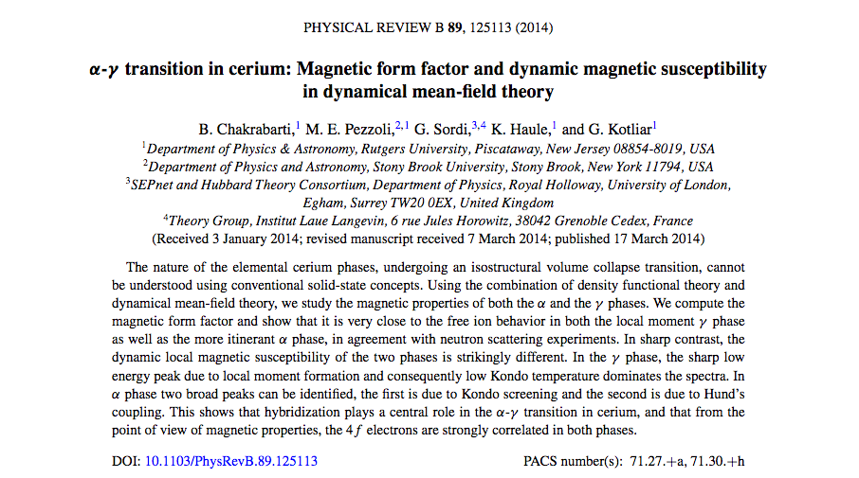
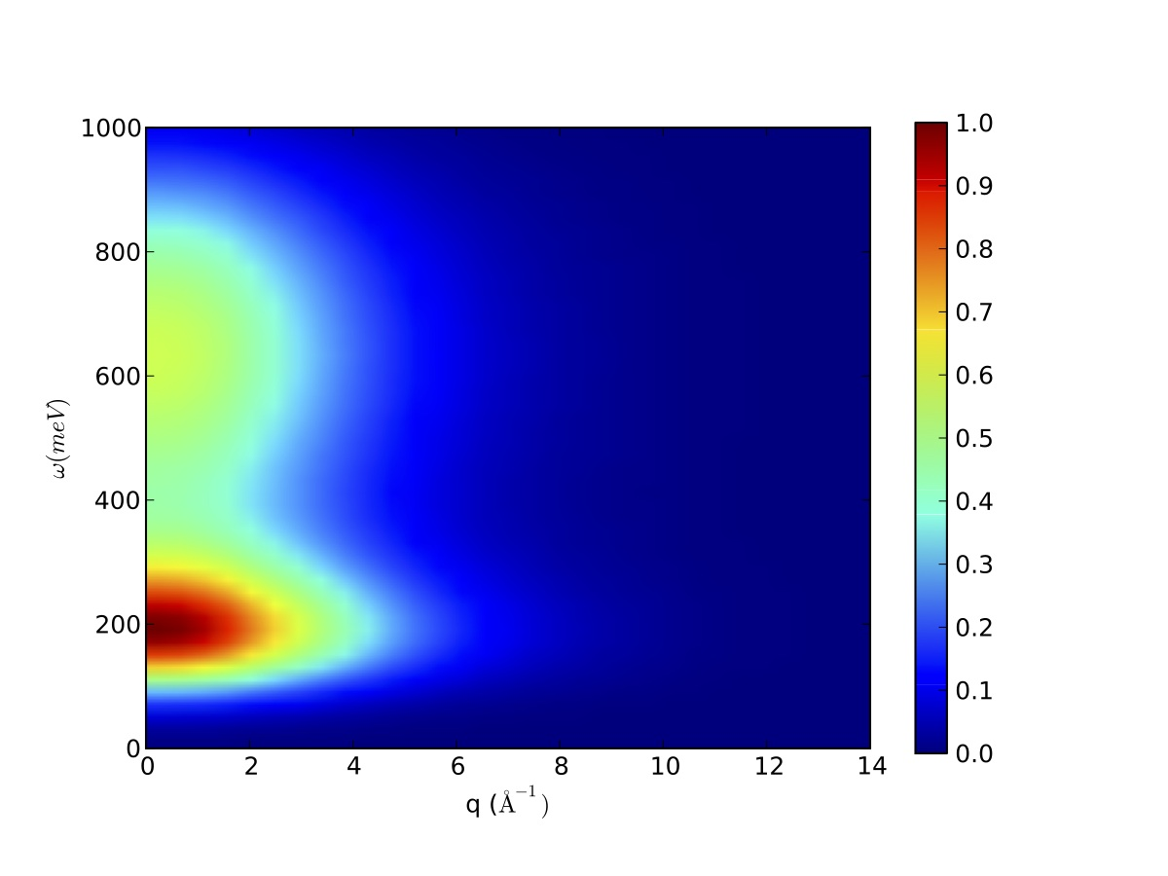
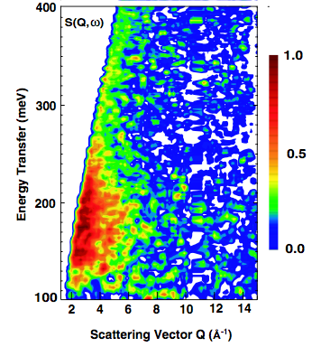

DMFT results for $S\left(q,ω\right)$
Almost perfect Agreement!

Slide 21
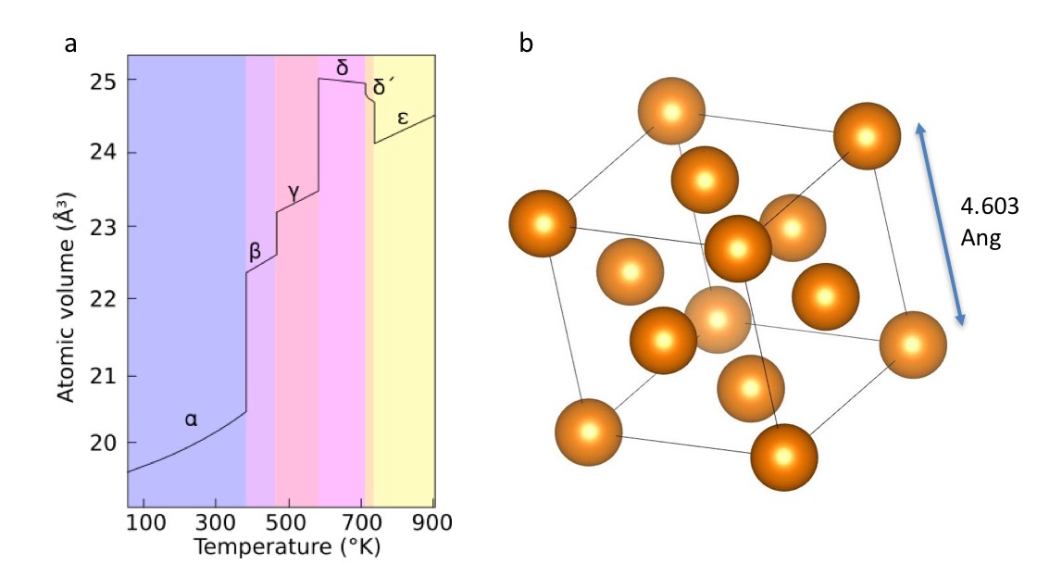
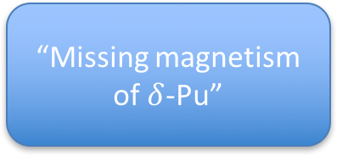

The valence fluctuating ground state of $δ$-Pu
Plutonium has a highly complex phase diagram.
Theories which reproduce unit cell volume predict static moment
Pauli Susceptibility
Anomalously high C_{v}
Experiments disagree!
“Missing magnetism of $δ$-Pu”

Slide 22
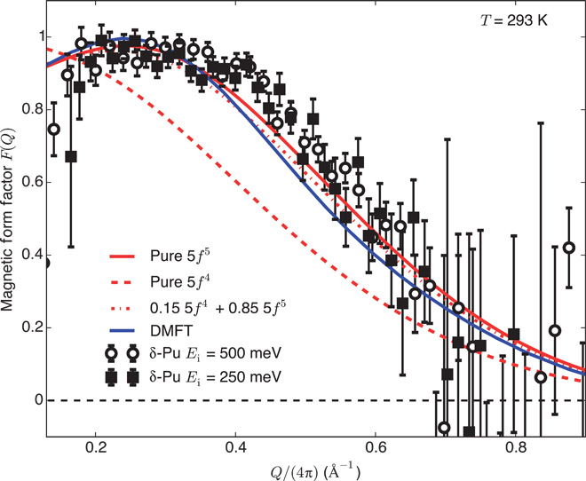
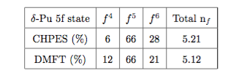
Magnetic Form Factor & Valence fluctuations
Large fluctuations in occupation of 5f orbital- captured by DMFT
Put in my citation

Slide 23
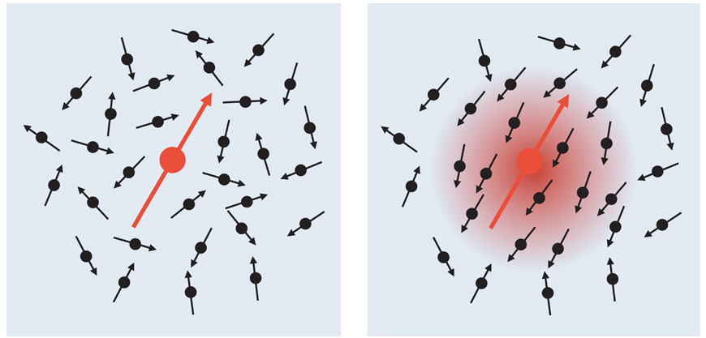
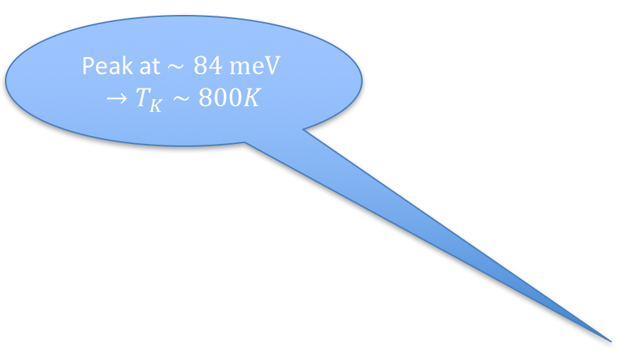
The Missing magnetism
Peak at $∼84 \text{meV} →T_{K}∼800K$
At room Temperature Magnetic moment is screened by Kondo cloud
T>T_{K}
T<T_{K}

Slide 24
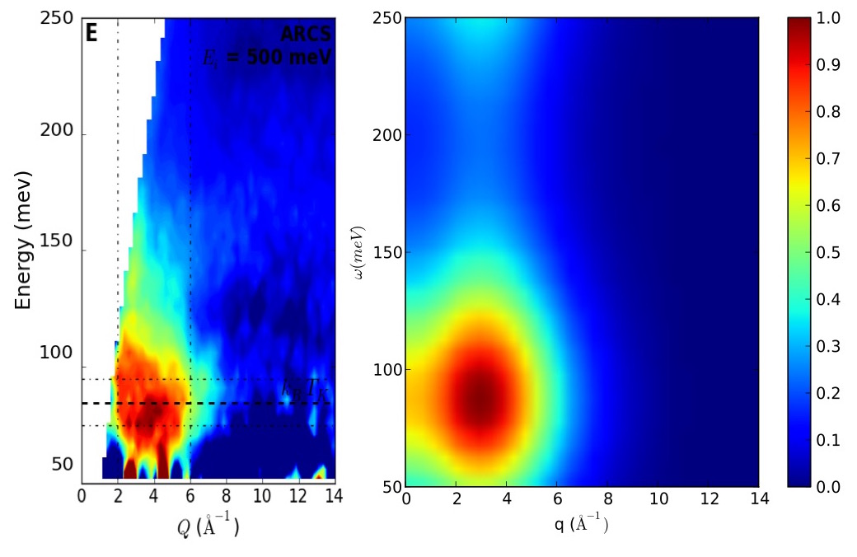
Almost perfect Agreement!

Slide 25
Spin state Transition in LaCoO₃

Slide 26
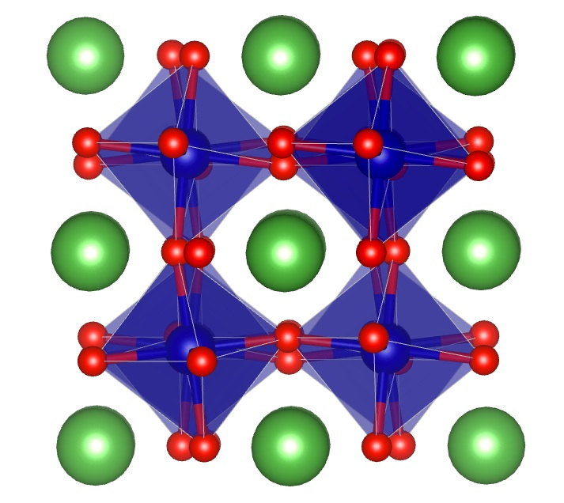
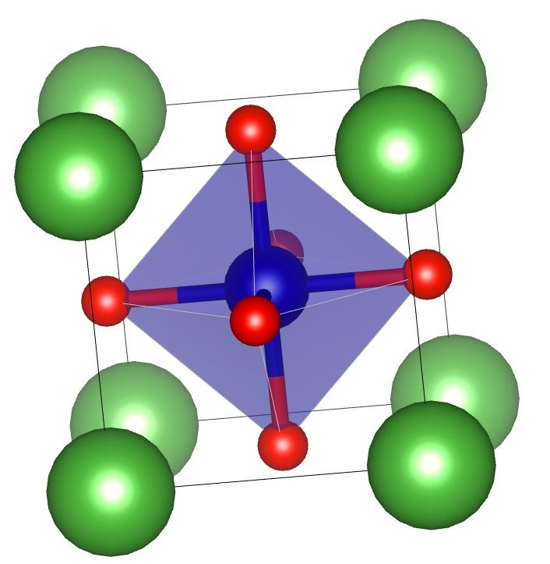
Why LaCoO₃?
LaCoO₃ is a perovskite (ABO₃) with La on the A site and Co on the B site surrounded by Oxygen Octahedra.
The Octahedra undergo out of phase rotations along the [111] axis (a⁻a⁻a⁻ tilt pattern)
Narrow band-gap insulator at low temp (<60K) with Pauli-like susceptibility.
Between 90-150 K, transitions to a local moment phase with Curie-Weiss like susceptibility. Gradual closing of the insulating gap, known to be metallic above 600K.
O
La
Co

Slide 27
Why LaCoO₃?(contd..)
The main puzzle is to determine the spin state of the nominally 3d⁶ Co ion which characterizes the local moment phase at high temperature.
Much disagreement between theoretical approaches. Experiments have also not been able to unambiguously settle the issue
Must also explain the non-concurrent metal-insulator transition taking place at higher temperature than spin state transition.
e_{g}
e_{g}
t_{2g}
t_{2g}
(“ Low to Intermediate Spin”)
(“ Low to High Spin”)

Slide 28
Aim of our Project
Fully charge self-consistent DFT+DMFT on LaCoO₃ in order to investigate the true nature of the Spin State (SS) transition and Metal-Insulator transition (MIT) in LaCoO₃.
Wien-DMFT package developed at Rutgers. DMFT on top of Wien2k DFT package. Numerically exact state-of-the-art CTQMC impurity solver
Importance of structural factors such as octahedral rotations and thermal expansion in bringing about the transitions.
Importance of electronic entropy in stabilizing the local moment phase of LaCoO3.

Slide 29
Structures studied
To study the effects of octahedral rotations and thermal expansion on the transitions, we study 4 different structures
Structures from neutron scattering experiments (Thornton et. al).
Low Temperature Structure at 4 K (LTa⁻ structure).
High Temperature Structure at 1143 K (HTa⁻ structure)
Fictitious Structures with no octahedral rotations (a⁰a⁰a⁰ pattern)
With same lattice vectors as 4K structure (LTa⁰ structure)
With same lattice vectors as 1143 K structure (HTa⁰ structure)
For all 4 structures we perform simulations at temperatures between 116K and 1160 K.

Slide 30
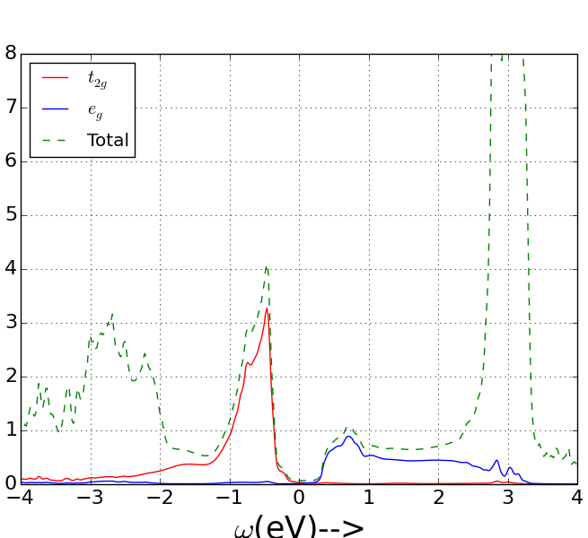
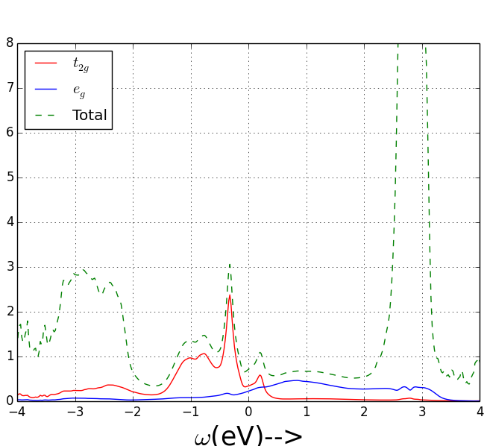
Density of States
We see a clear metal insulator transition as a function of temperature in all but the LTa^{0.} Considerable overlap between t2g and eg orbitals at high temperature.
HTa⁻
T=116K
T=1160K

Slide 31
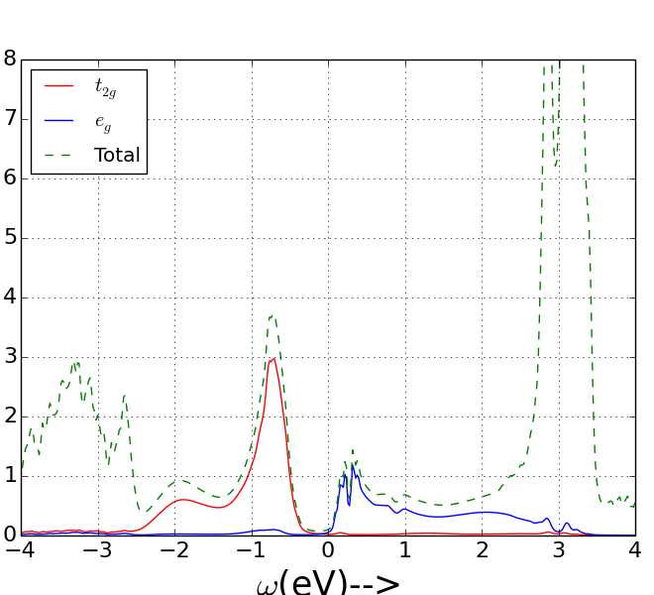
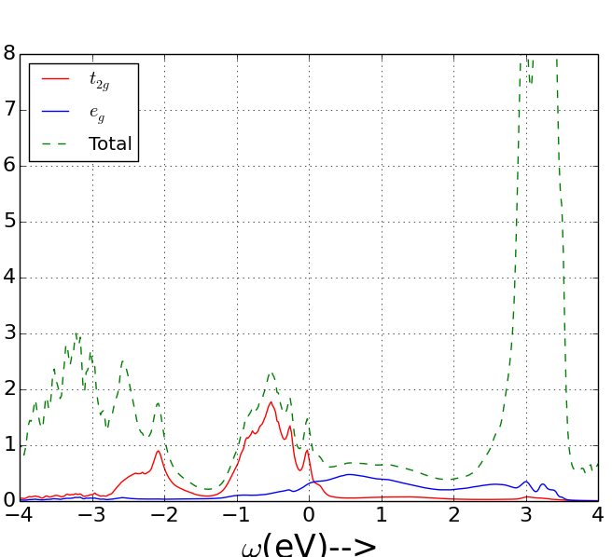
Density of States
We see a clear metal insulator transition as a function of temperature in all but the LTa^{0.} Considerable overlap between t2g and eg orbitals at high temperature.
LTa⁻
T=116K
T=1160K

Slide 32
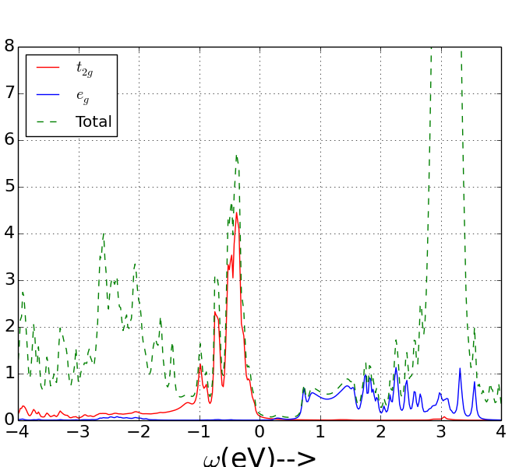
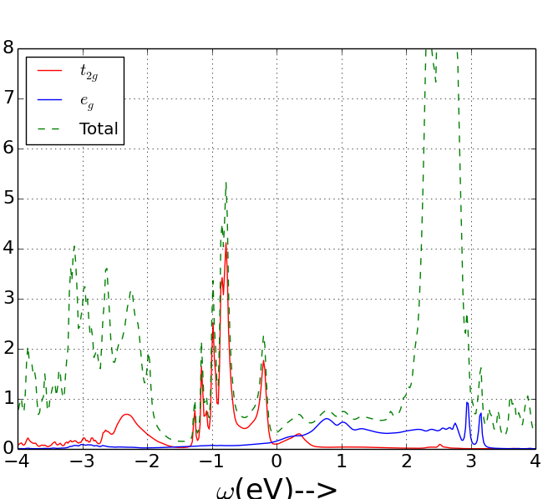
Density of States
We see a clear metal insulator transition as a function of temperature in all but the LTa^{0.} Considerable overlap between t2g and eg orbitals at high temperature.
HTa⁰
T=116K
T=1160K

Slide 33
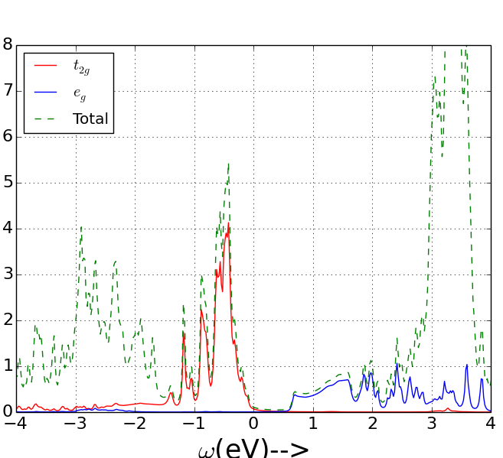
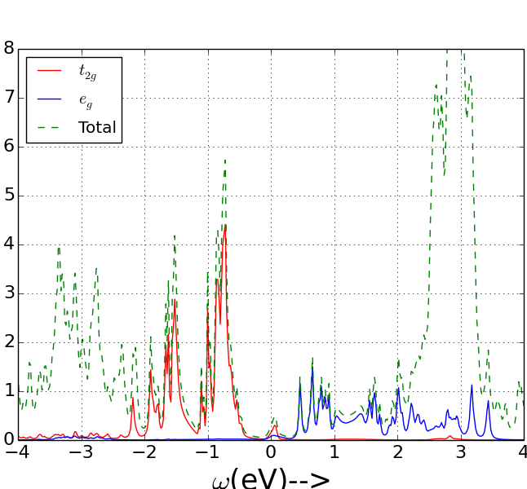
Density of States
We see a clear metal insulator transition as a function of temperature in all but the LTa^{0.} Considerable overlap between t2g and eg orbitals at high temperature.
LTa⁰
T=116K
T=1160K

Slide 34
Measuring the Spin state
The CTQMC impurity solver gives probabilities of the 1024 different states of the Co 3d orbital. allows us to calculate the expectation value of |S_{Z}|.
We find that the actual occupancy of the Co d orbital is ~6.6 due to hybridization with O atoms which results in large valence fluctuations.
Not accurate to think of the spin state in terms of only the d⁶ state!
We measure the evolution of the Probability of all values of |S_{Z}|as a function of temperature for all 4 structures.

Slide 35
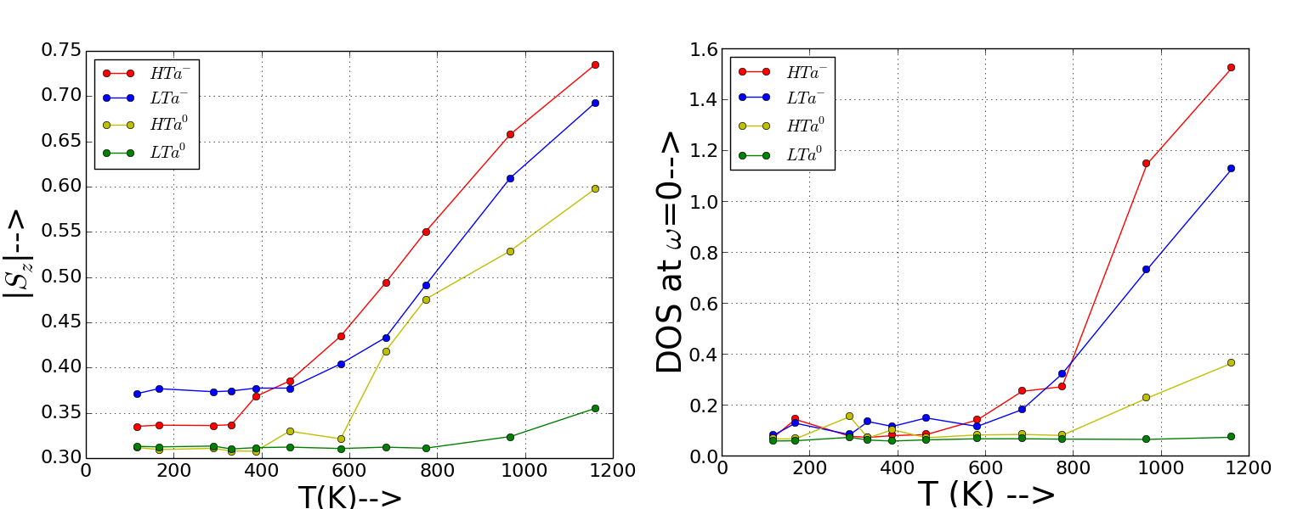
The Spin State Transition!!
Transition Temp higher than Expt!
Earliest & Strongest Transition in HTa⁻
Almost NO Transition in LTa⁰

Slide 36
Non-concurrent Transitions!!
T_{ss} HTa⁻
T_{MIT} HTa⁻

Slide 37
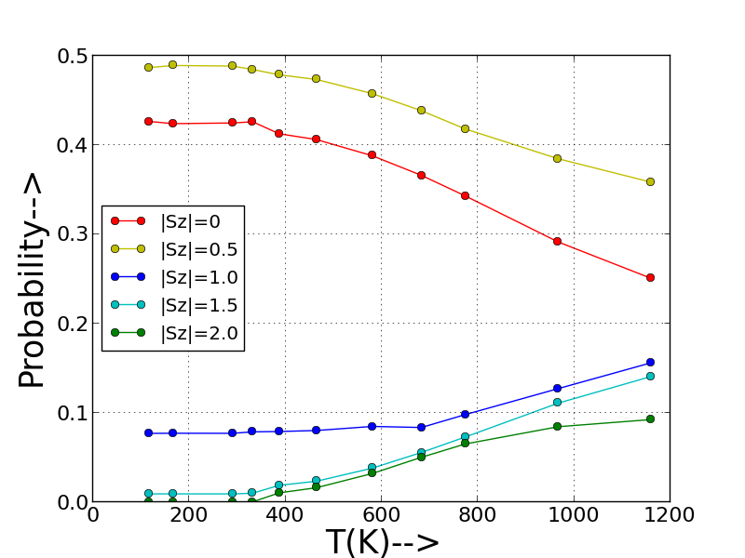



Which Multiplet is to blame?
T_{ss}
T_{ss}
HTa⁻
LTa⁻
HS excitation
HS excitation
T_{ss}
T_{ss}
HTa⁰
LTa⁰
HS excitation
HS excitation

Slide 38
Importance of Electronic Entropy
According to entropy driven scenario, LaCoO₃ prefers higher spin multiplets due to Entropy gain.
To test effect of structural factors on electronic entropy we compute the Entropy difference between LTa⁻ and HTa⁻ structures at 1160K using state of the art Entropy calculation technique(Birol et.al)
Gain in T•S of 110 meV per formula unit in HTa- compared to LTa- structure. Stabilizes HTa⁻ structure
Shows that electronic entropy is vital in stabilizing the thermal expansion and driving the spin state transition in the material.
HTa⁻
LTa⁻
F=E-T•S
Energy
(E)
Free Energy
(F)
LTa⁻
HTa⁻
1160K

Slide 39
Conclusions
We performed fully charge self-consistent DFT+DMFT calculations on LaCoO3 to study the spin state and metal-insulator transitions.
Obtained non-concurrent spin state and metal-Insulator transitions. However spin state transition occurs at slightly too high temperature.
Determined that HS state is the first to get excited at the onset of the spin state transition for all occupancy sectors.
Larger octahedral rotations and lattice expansion favor the spin state transition.
Studied the importance of electronic entropy and found it to be essential in driving the structural transitions in the material.

Slide 40
Thank You

